Slide 1
Create, Read, Update, Delete (CRUD) with jQuery and AJAX
L10 – Manage Students
C273 – Advanced Web Application Development in PHP

Slide 2
Today's problem
Create an application to perform Create, Read, Update and Delete functions in a single web page using AJAX and jQuery.

Slide 3
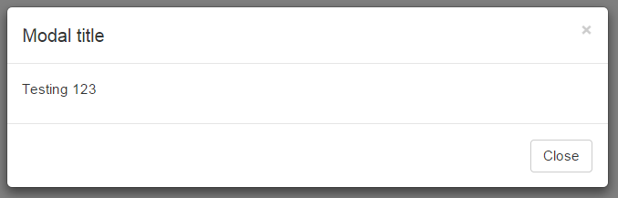
Bootstrap Modal
A modal is a child window that is layered over its parent window.
The purpose is to display content from a separate source that can have some interaction without leaving the parent window.

Slide 4
Bootstrap Modal
<!-- Button trigger modal -->
<button class="btn btn-primary btn-md" data-toggle="modal" data-target="#myModal"> Launch modal </button>
<!-- Modal -->
<div class="modal fade" id="myModal" role="dialog">
<div class="modal-dialog">
<div class="modal-content">
<div class="modal-header">
<h4 class="modal-title">Modal title</h4>
</div>
<div class="modal-body">
<p>Testing 123</p>
</div>
<div class="modal-footer">
Header
Body
<button type="button" class="btn btn-default" data-
dismiss="modal">Close</button>
Footer
</div>
</div><!-- /.modal-content -->
</div><!-- /.modal-dialog -->
</div><!-- /.modal -->

Slide 5
Dynamically created buttons
Whenever the page reloads, an AJAX call is made to retrieve the list of modules and creates the table of records, Edit and Delete buttons.
You can’t create a click callback function for .btnEdit using this:
$(“.btnEdit").click(function() {
});
As the Edit buttons are generated dynamically
You need to create a “delegated” binding using on() method:

Slide 6
Delegated events
The click() binding you're using is called a "direct" binding which will only attach the handler to elements that already exist. It won't get bound to elements created in the future. To do that, you'll have to create a "delegated" binding by using on().
Delegated events have the advantage that they can process events from descendant elements that are added to the document at a later time.
http://learn.jquery.com/events/event- delegation/

Slide 7
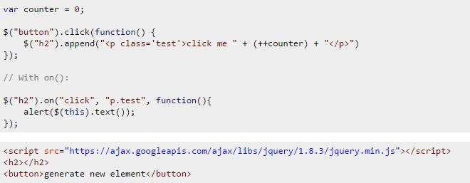
Delegated events

Slide 8
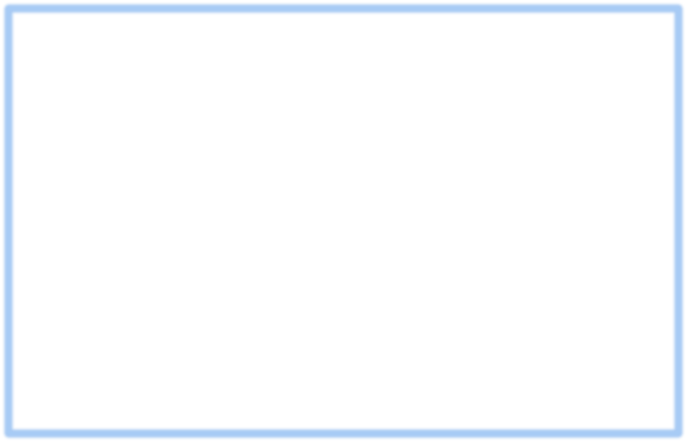
manageStudents.js
function reload_table() {
$.ajax({
type: "GET",
url: "getStudents.php", cache: false,
dataType: "JSON",
success: function (response) { var message = "";
for (i = 0; i < response.length; i++) { message += "<tr>"
+ "<td>" + response[i].student_id + "</td>"
+ "<td>" + response[i].first_name + "</td>"
+ "<td>" + response[i].last_name + "</td>"
There are many Edit buttons,
however “id” has to be unique for each button, therefore “class” is used
+ "<td><button class='btnEdit btn btn-primary' value='" + response[i].student_id + <i class='fa fa-edit'></i> Edit</button>&nbsp;&nbsp;"
+ "<button class='btnDelete btn btn-danger' value='" + response[i].student_id + <i class='fa fa-trash'></i> Delete</button></td>"
+ "</tr>";
}
$("#defaultTable tbody").html(message);
To identify which Edit button is clicked. We always use the primary key for the button value
},
error: function (obj, textStatus, errorThrown) { console.log("Error " + textStatus + ": " + errorThrown);
}
});
}

Slide 9
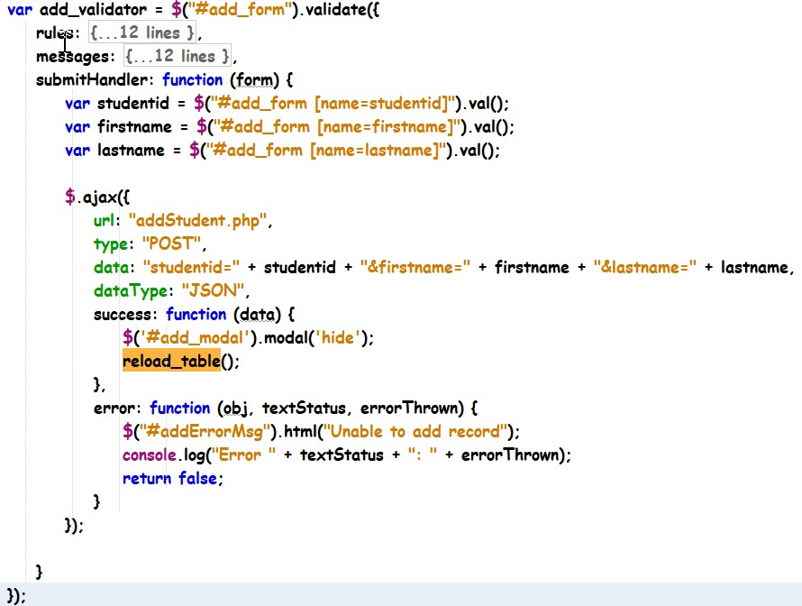
manageStudents.js - continue
Upon successful adding or updating of the category, the modal is hidden and the list of categories is retrieved from the webservice again.

Slide 10

manageStudents.js
$(document).ready(function () {
reload_table();
Reset the modal form input values once the modal is hidden to prevent the showing of
$('#add_modal').on('hidden.bs.modal', function () {
$('#add_form')[0].reset(); add_validator.destroy();
});
previously entered values
$("#btnAdd").click(function () {
$('#add_form').modal('show');
});
Display the modal when the Add button is clicked

Slide 11
getStudentDetails.php JSON Message
PHP Code
Test on web browser
http://localhost/C273Webservices/getStudentDetails.php?student_id=1111111
JSON Output
{
student_id: "1111111", first_name: "Bob", last_name: "Tan"
}

Slide 12

manageStudents.js - continue
You can’t use:
$("#defaultTable").on("click", ".btnEdit", function () { var id = $(this).val();
$.ajax({
$(“.btnEdit”).click(function(){ as the Edit
buttons are created dynamically. You need to use delegated binding
url: "getStudentDetails.php", data: "student_id=" + id, type: "GET",
cache: false, dataType: "JSON",
success: function (data) {
Retrieve Edit button’s value
Retrieve JSON messages’ keys
$('#edit_form [name=studentid]').val(data.student_id);
$('#edit_form [name=firstname]').val(data.first_name);
$('#edit_form [name=lastname]').val(data.last_name);
$('#edit_modal').modal('show');
Set key values to modal form’s input values.
Show modal
},
error: function (obj, textStatus, errorThrown) { console.log("Error " + textStatus + ": " + errorThrown);
}
});
});
You need to specify $(‘#edit_form [name=lastname]‘) as the input field
‘lastname‘ exists in #add_form as well

Slide 13


manageStudents.js - continue
$("#defaultTable").on("click", ".btnDelete", function () { var id = $(this).val(); if (confirm('Are you sure you want to delete this student?')) { // ajax delete data to database $.ajax({ url: "deleteStudent.php", data: "studentid=" + id,
type: "GET", dataType: "JSON", success: function (data) { reload_table(); }, error: function (obj, textStatus, errorThrown) { |  |  |  |  | Same as deleteStudent.php
}); | } | }); | } | console.log("Error " + textStatus + ": " + errorThrown);

Slide 14
What you learnt today
Apply Bootstrap components, Modal and FontAwesome icons, on web pages
Perform form submission using AJAX and jQuery via the POST method
Explain the difference between direct event binding and delegated event binding
Apply event delegation using the on() method
Apply AJAX and jQuery to build a datagrid that dynamically add, edit and delete rows in a single web page.

